Slide 1
Shooting Gallery
Andrew Bryner
Shooting-Gallery

Slide 2
Goals
Shooting Gallery game with multiple target types.
CSS animation for targets when they got shot.
Timer which would end the turn forcing the player to shoot targets as quickly as possible.
Attempt at Object Oriented Programming.
Working game logic with working transitions at all stages of play.
Scoring and High Scores.

Slide 3
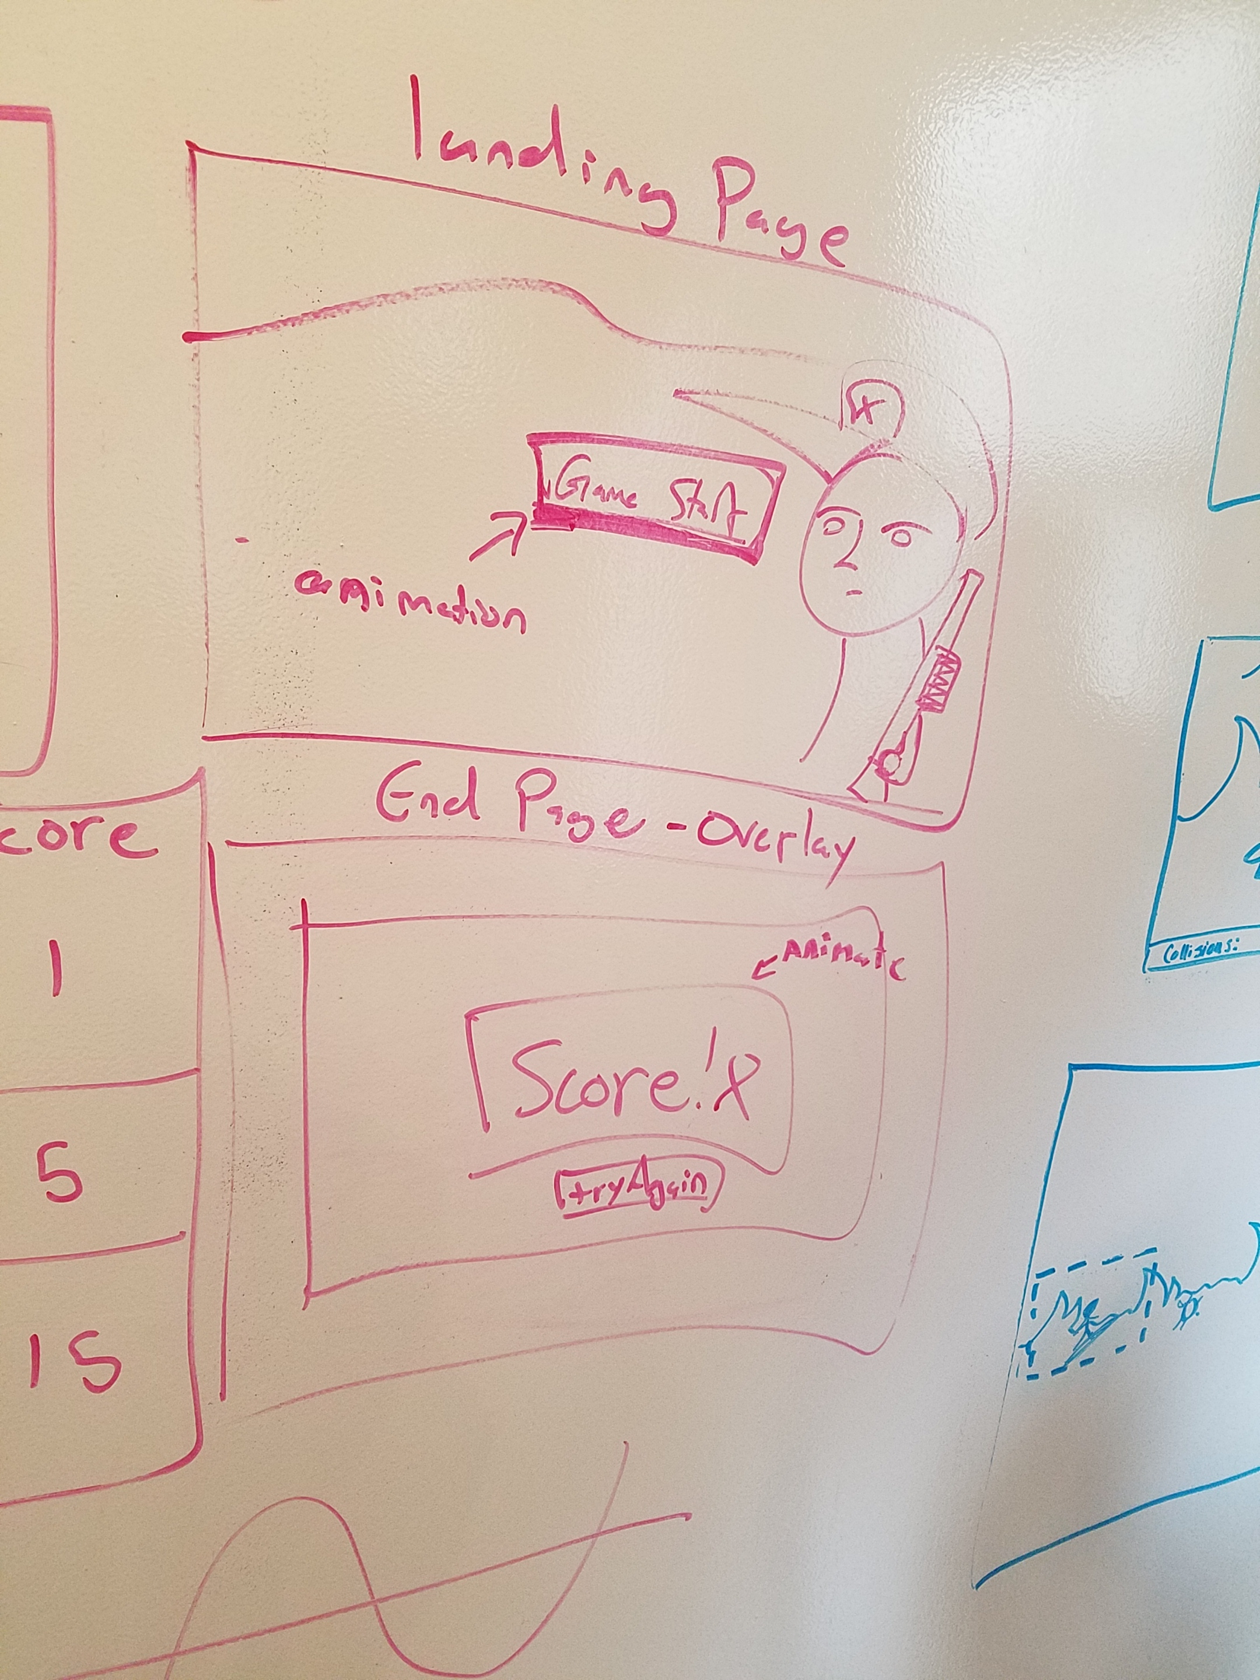
Wireframing
Simple Landing page
Concept for Simple Overlays
Didn’t get around to hunter image on front page.

Slide 4
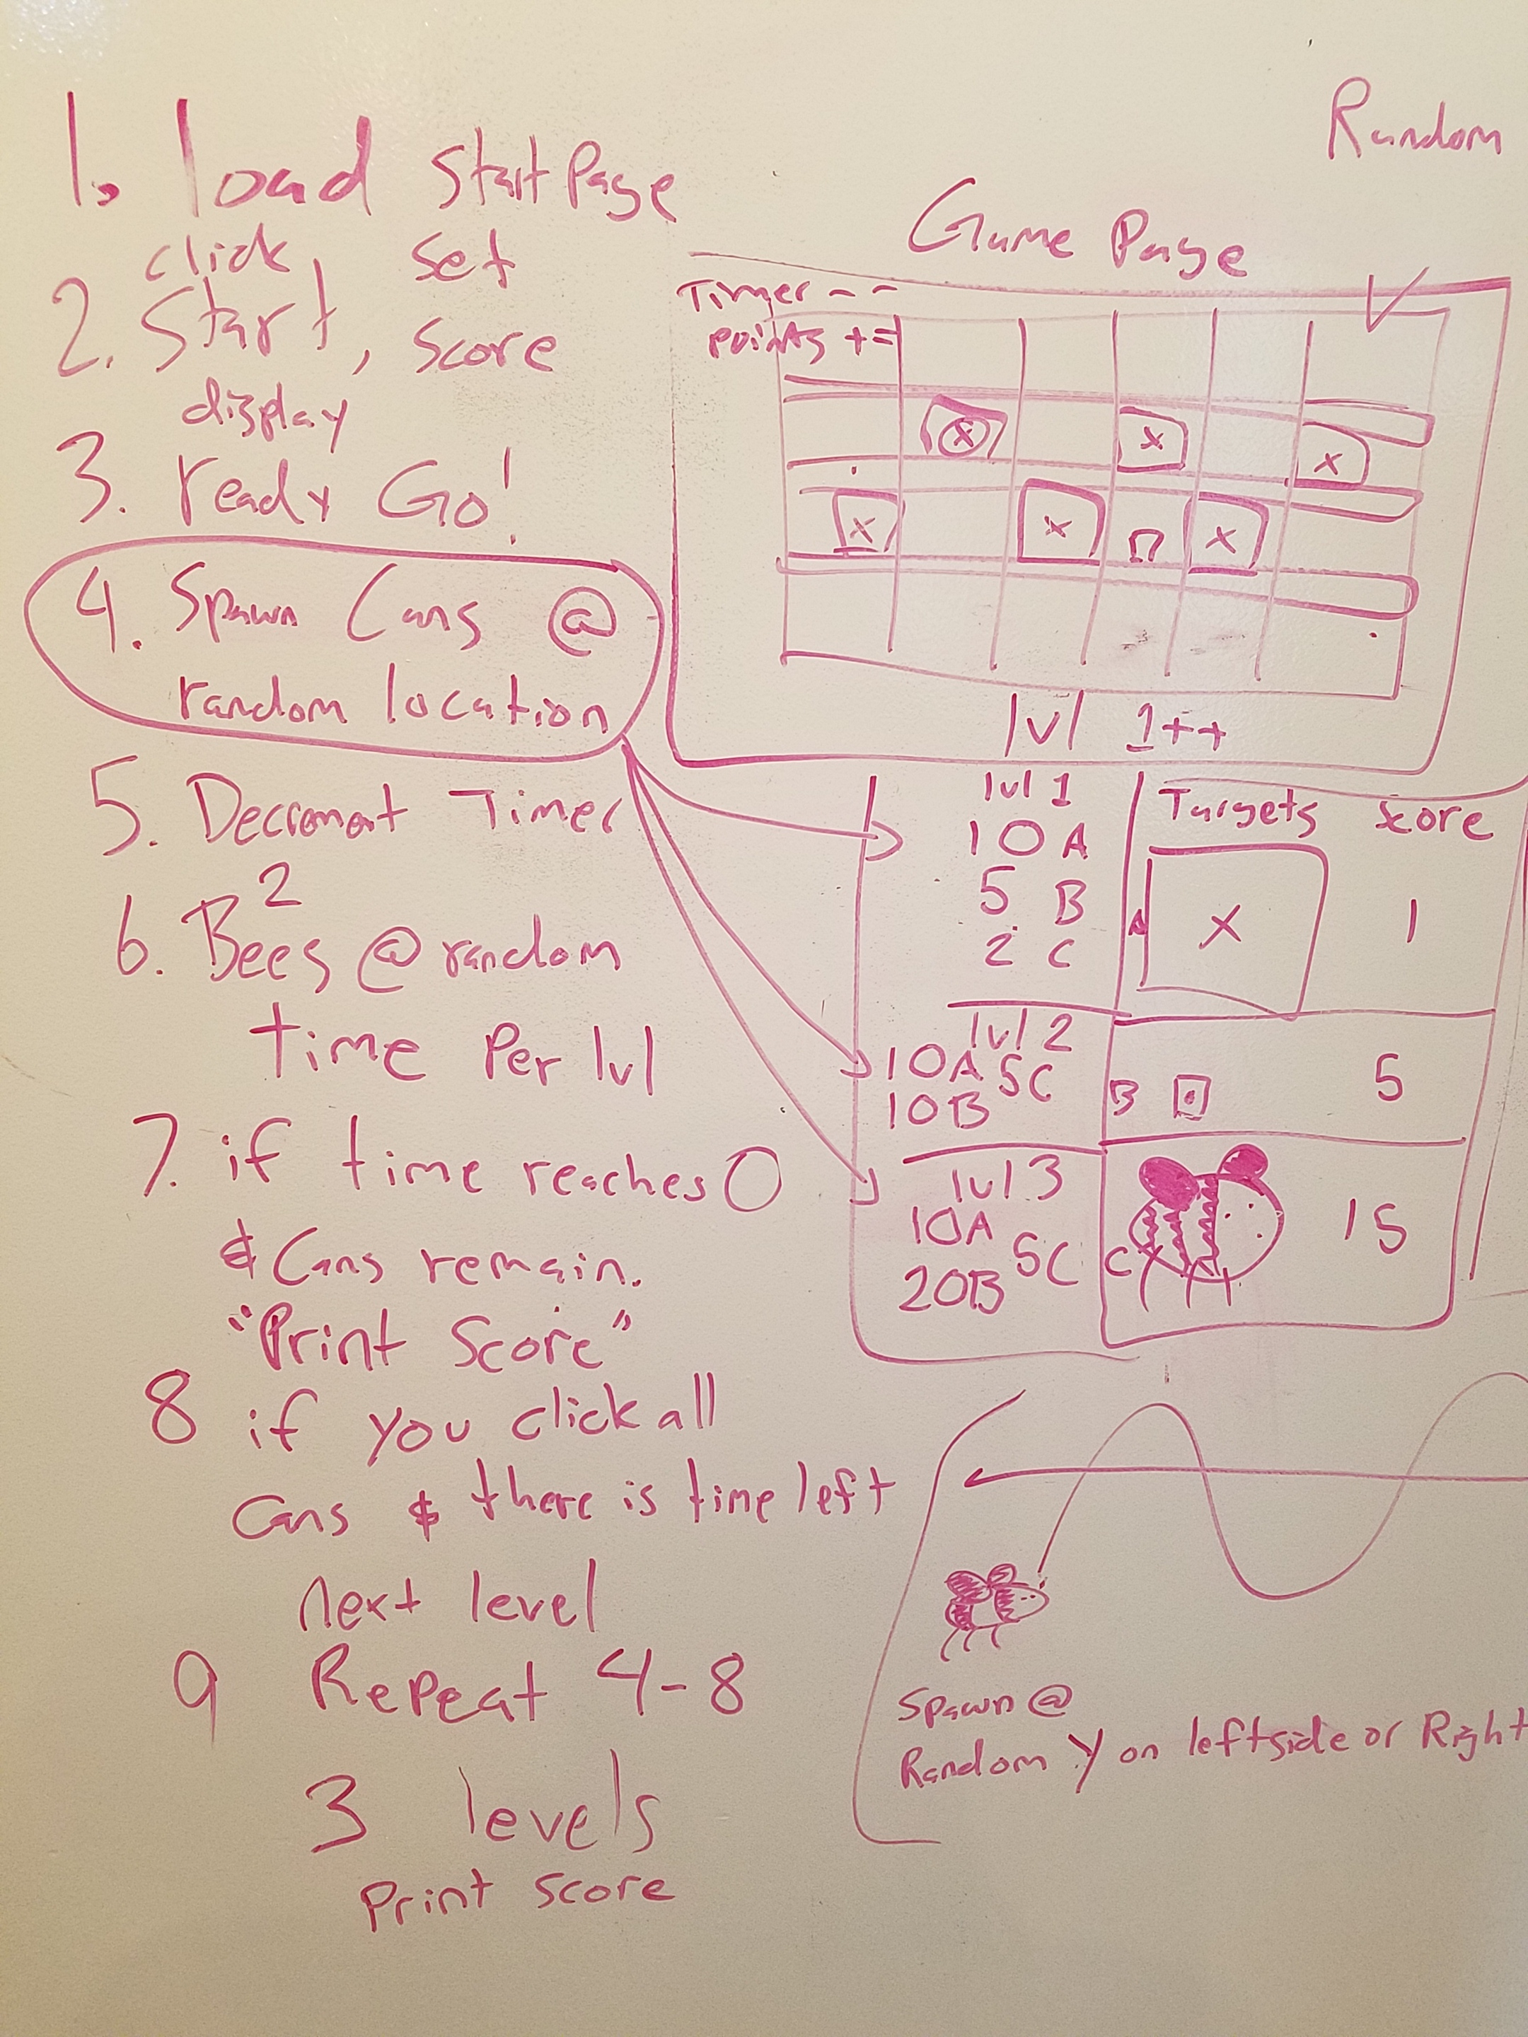
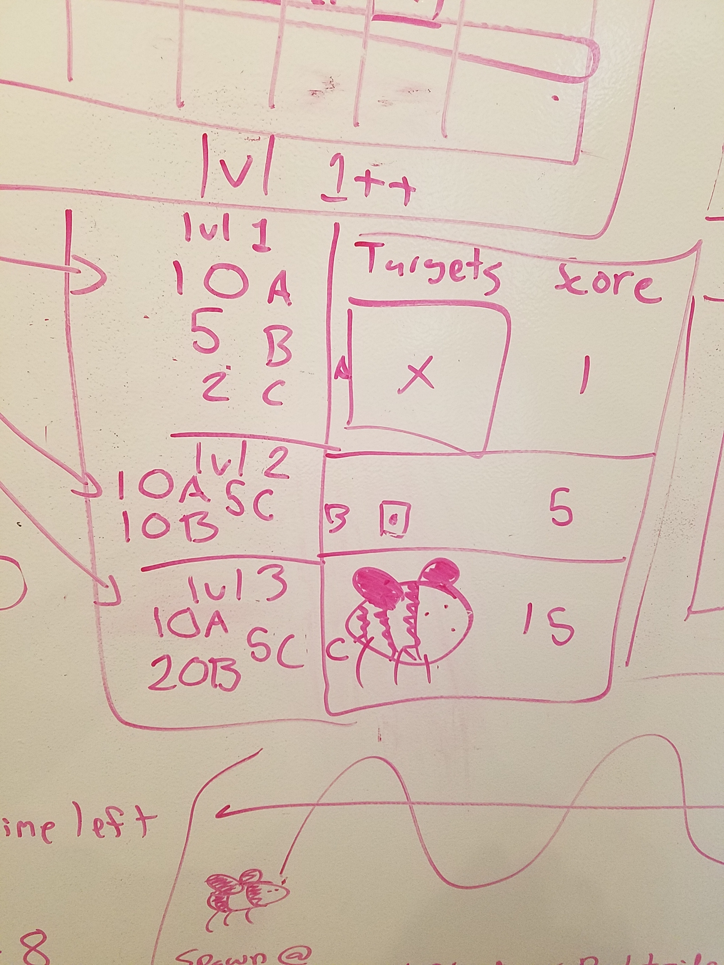

Slide 5
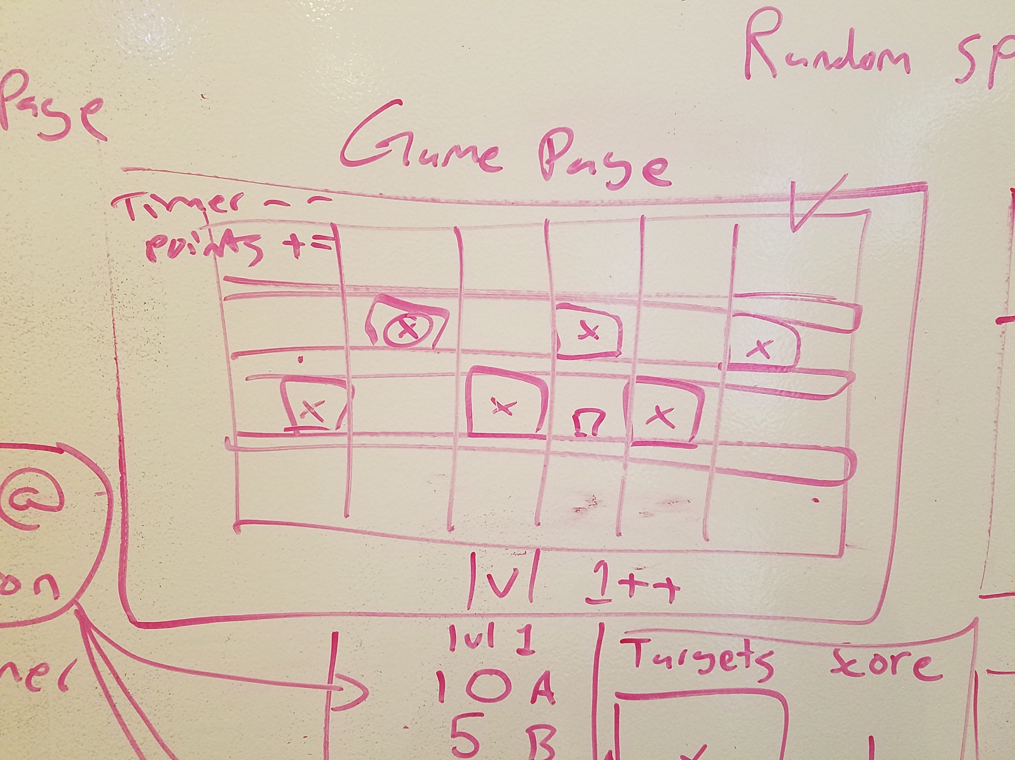

Slide 6
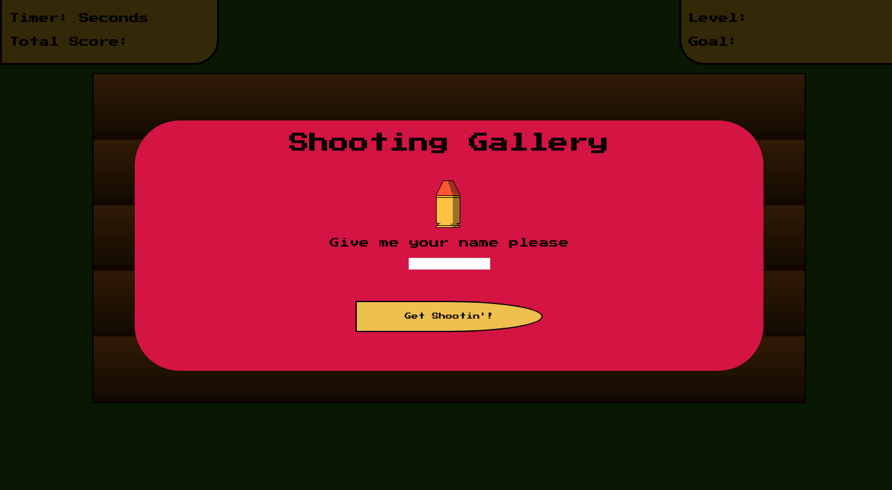
Features
Timer
Score Keeping & High Scoreboard
Fast-paced shooting gameplay
CSS animations on navigation to the game page and on shooting targets
Pixel Art

Slide 7
Difficulties and Constraints
Building an array with a defined length of non-repeating random numbers.
Object Oriented Programming
Simplifying Code into better sized chunks.
CSS and Responsiveness
Complexity

Slide 8
Final Thoughts and Future Goals
Fun project
I am happy with how it turned out.
I would still like to make the main game page look nicer somehow.
The Bee
Sound Effects
Landing Screen Animation

